Slide 1
The Limits to Growth: Sustainability and the Circular Economy
Lecture 10: Now What?
Prof. Dr. Benjamin Leiding
M.Sc. Anant Sujatanagarjuna

Slide 2
License
This work is licensed under a Creative Commons Attribution-ShareAlike 4.0 International License. To view a copy of this license, please refer to https://creativecommons.org/licenses/by-sa/4.0/ .
Updated versions of these slides will be available in our Github repository.

Slide 3
News/Updates

Slide 4
Exam
Pre-Exam Q&A Session
There will be a pre-exam Q&A session (via BBB) before the exam
We will announce date and time in the next few days

Slide 5
Bonus Task
Feedback
No video submission, yet.

Slide 6
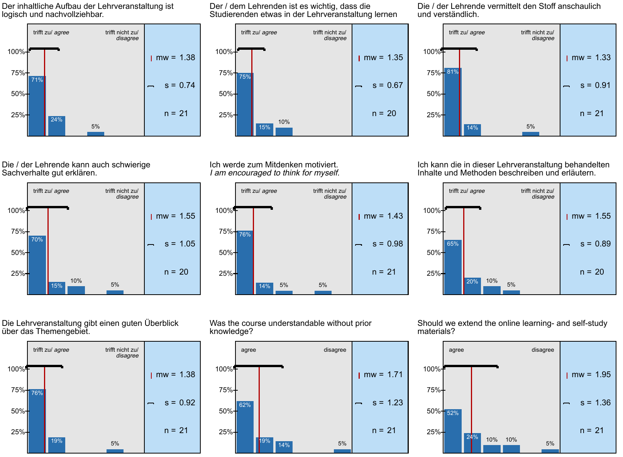
Course Evaluation Results
Feedback

Slide 7
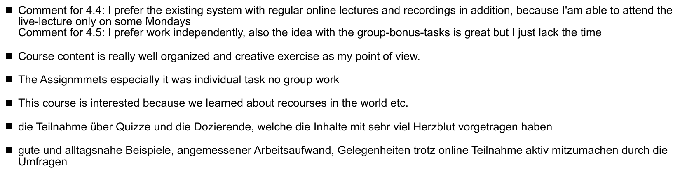
Course Evaluation Results
Feedback

Slide 8
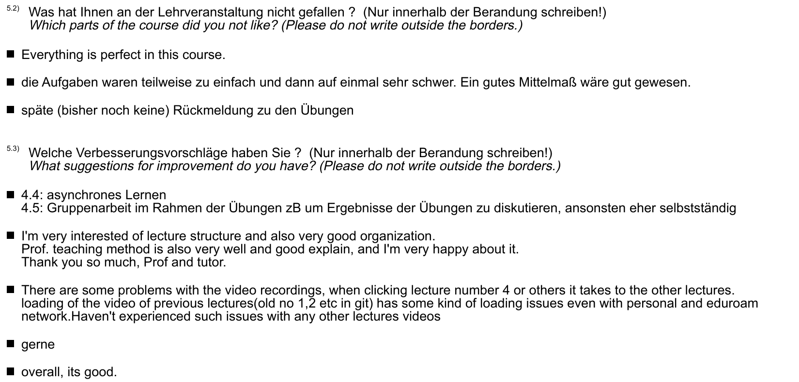
Course Evaluation Results
Feedback

Slide 9
Exercise 07

Slide 10
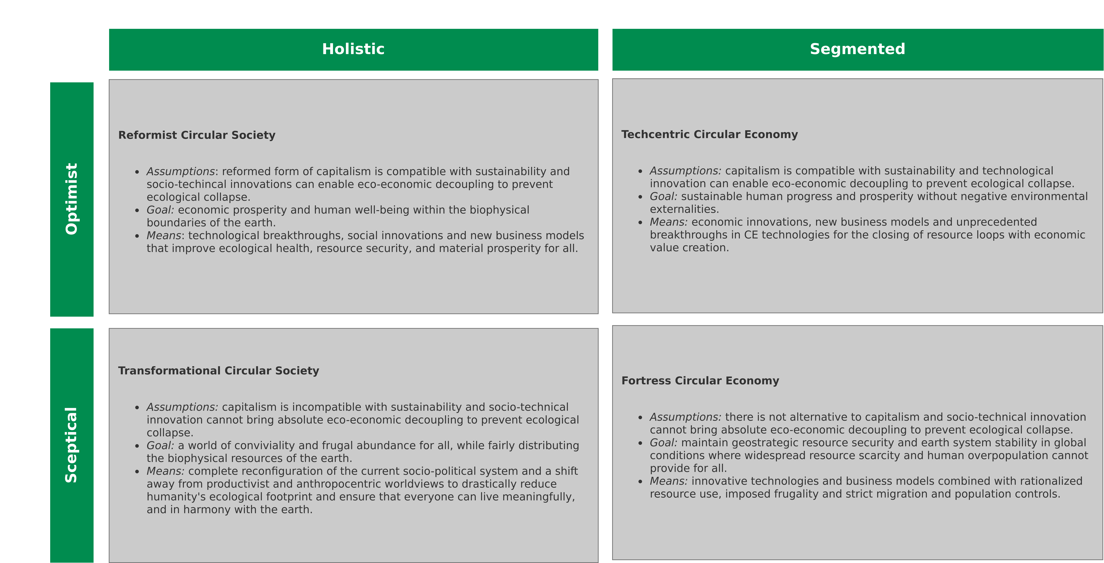
Exercise 07
Refresh
Image recreated from: M. C. Friant, R. Salomone, W. J. V. Vermeulen (2020) – A Typology of Circular Economy Discourses: Navigating the Diverse Visions of a Contested Paradigm – Link

Slide 11
Exercise E07
Feedback
A lot of empty submissions
Some submissions that only selected one of the options → no explanations
Other submissions just reiterated what was written on the slide
Five cases of plagiarism
Votes: 13
Reformist CS (Optimist + Holistic): 3
Techcentric CE (Optimist + Segmented): 2
Transformational CS (Sceptical + Holistic): 6
Fortress CE (Skeptical + Segmented): 2

Slide 12
Exercise E07
Feedback
A lot of empty submissions
Some submissions that only selected one of the options → no explanations
Other submissions just reiterated what was written on the slide
Five cases of plagiarism
Votes: 13
Reformist CS (Optimist + Holistic): 3
Techcentric CE (Optimist + Segmented): 2
Transformational CS (Sceptical + Holistic): 6
Fortress CE (Skeptical + Segmented): 2

Slide 13
Exercise E07
Feedback
A lot of empty submissions
Some submissions that only selected one of the options → no explanations
Other submissions just reiterated what was written on the slide
Five cases of plagiarism
Votes: 13
Reformist CS (Optimist + Holistic): 3
Techcentric CE (Optimist + Segmented): 2
Transformational CS (Sceptical + Holistic): 6
Fortress CE (Skeptical + Segmented): 2

Slide 14
Exercise E07
Feedback
A lot of empty submissions
Some submissions that only selected one of the options → no explanations
Other submissions just reiterated what was written on the slide
Five cases of plagiarism
Votes: 13
Reformist CS (Optimist + Holistic): 3
Techcentric CE (Optimist + Segmented): 2
Transformational CS (Sceptical + Holistic): 6
Fortress CE (Skeptical + Segmented): 2

Slide 15
Exercise 08

Slide 16
Exercise E08
Feedback
Coming soon.

Slide 17
Recap – LTG Course in a nutshell

Slide 18

LTG Recap
Climate Change – Global GHG Emission Pathways (2019)
Hannah Ritchie and Max Roser, adapted for svg and smartphone by Eric Fisk – https://commons.wikimedia.org/wiki/File:Greenhouse_gas_emission_scenarios_01.svg – CC BY-SA 4.0.

Slide 19
LTG Recap
Climate Change – 1.5°C vs. 2/3/4°C
“If we can keep warming below 3°C we likely remain within our adaptive capacity as a civilization, but at 2.7°C warming we would experience great hardship.” - Prof. Michael Mann

Slide 20
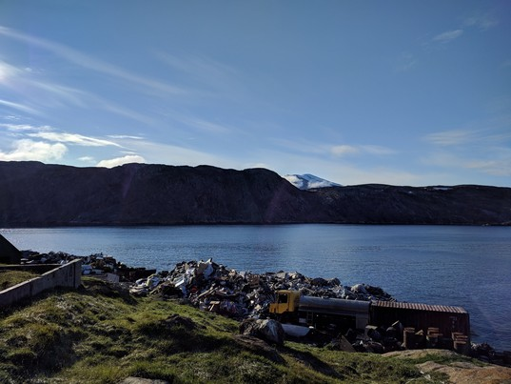
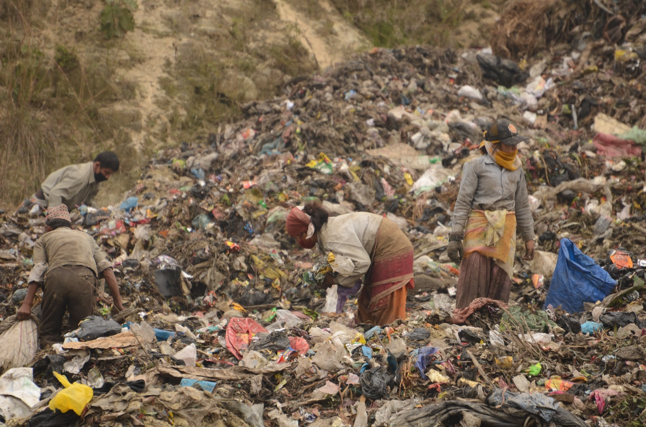
LTG Recap
Environmental Pollution – Waste
1. "Landfill at Upernavik" by ulalume – https://www.flickr.com/photos/96649248@N00/43867280734 – CC BY-NC-ND 2.0.
2. Christian Hüpfer – https://flic.kr/p/aKXw2F – CC BY-SA 2.0.

Slide 21
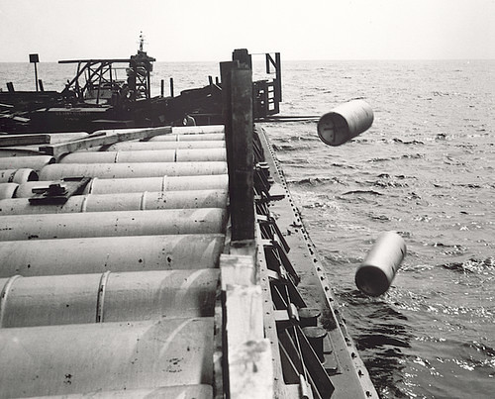
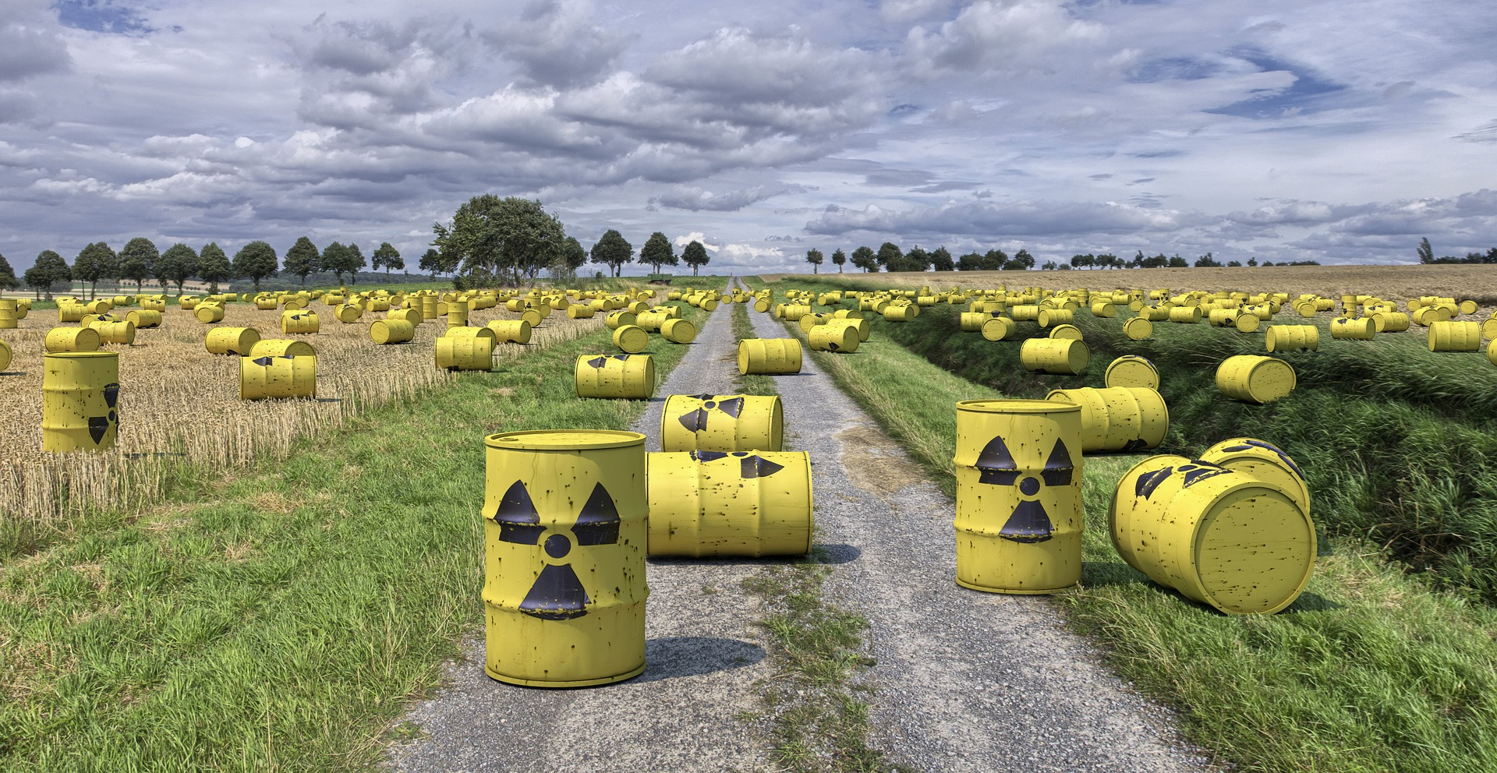
LTG Recap
Environmental Pollution – Horrible Waste Management
"Nuclear waste" by aaadrian365 is licensed with CC BY-NC 2.0. To view a copy of this license, visit https://creativecommons.org/licenses/by-nc/2.0/

Slide 22
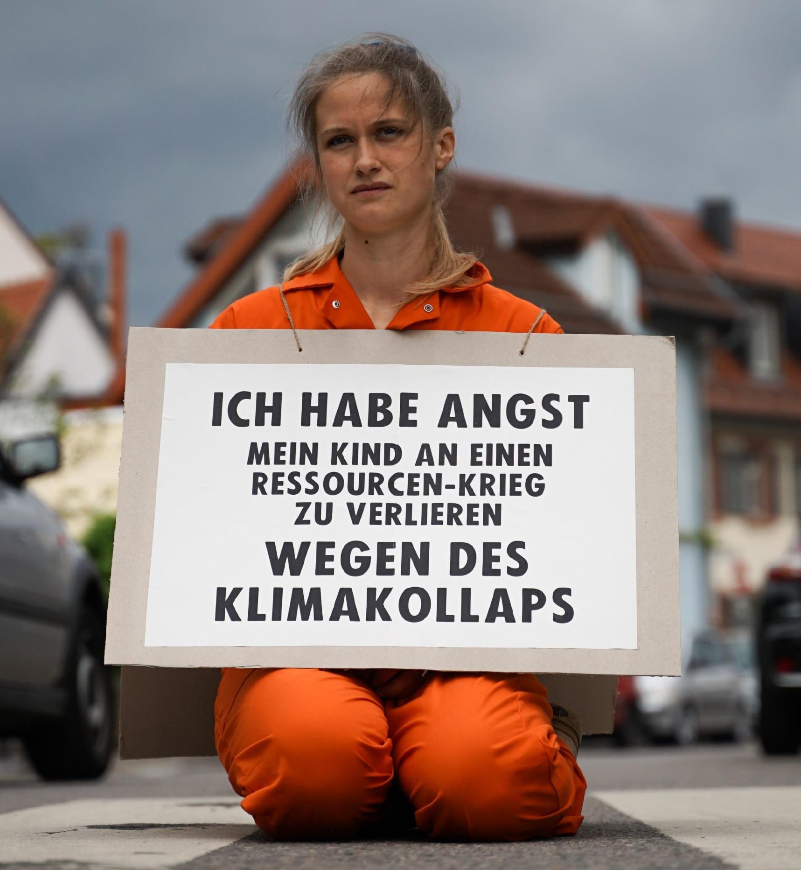
LTG Recap
Dwindling (Non-)Renewable Resources
“I am afraid of losing my child to a resource war because of a climate collapse”
→ “Our parents will die of old age, our children will die of climate change”
XR Strategiepapier 2022 – Pusteblumen und Hype. Bilder: Sebastian Höhn, Joe Pohl, Sandra Doneck, Alessandro Brönnimann

Slide 23
LTG Recap
3 Key Challenges of the 21st Century
Climate change / adaption to climate change
Environmental pollution
Dwindling non-renewable resources

Slide 24

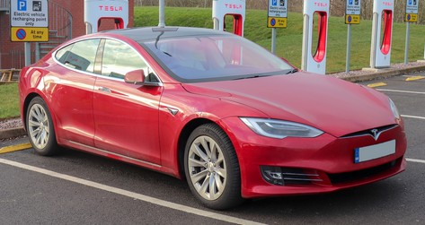
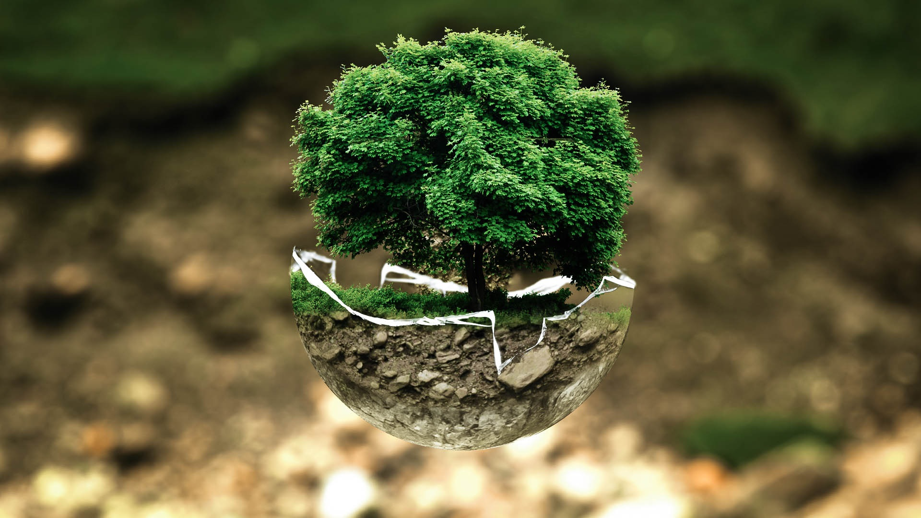
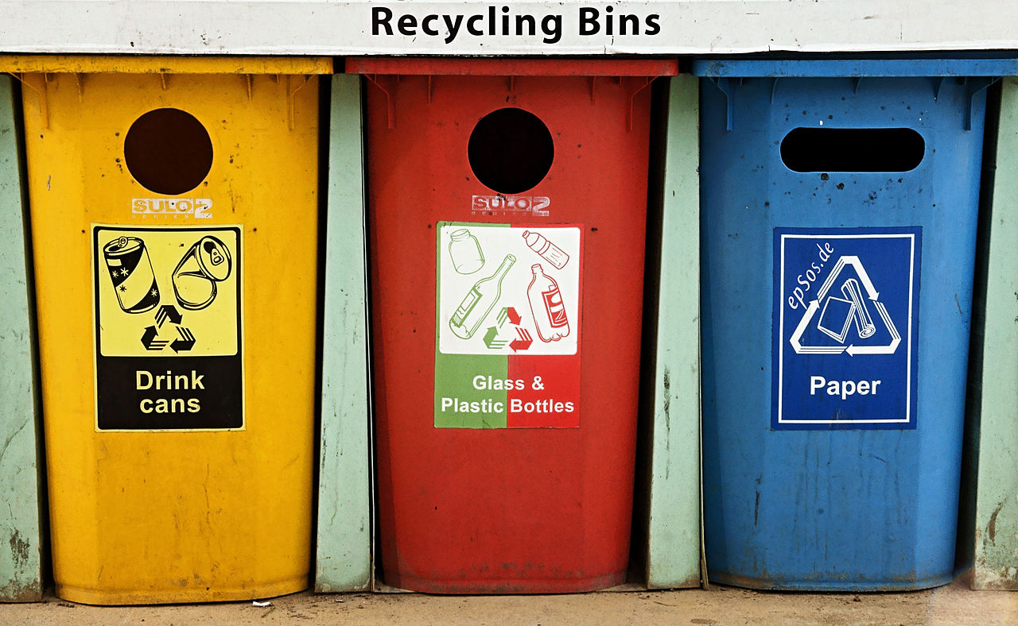
LTG Recap
Just Not Enough ...
1. Vauxford – https://commons.wikimedia.org/wiki/File:2018_Tesla_Model_S_75D.jpg – CC BY-SA 4.0.
2. Marco Verch – https://www.flickr.com/photos/30478819@N08/51303997289/in/photostream/ – CC BY 2.0.
3. https://pxhere.com/en/photo/1081335 – CC0 1.0.
4. epSos.de – https://commons.wikimedia.org/wiki/File:Colorful_Recycling_Containers_for_Trash.jpg – CC BY 2.0.

Slide 25

LTG Recap
Life-Cycle Assessment (LCA)
Battery Electric Vehicles (EV)
Or
Internal Combustion Engine Vehicles
Benjamin Leiding – CC BY-SA 4.0.

Slide 26
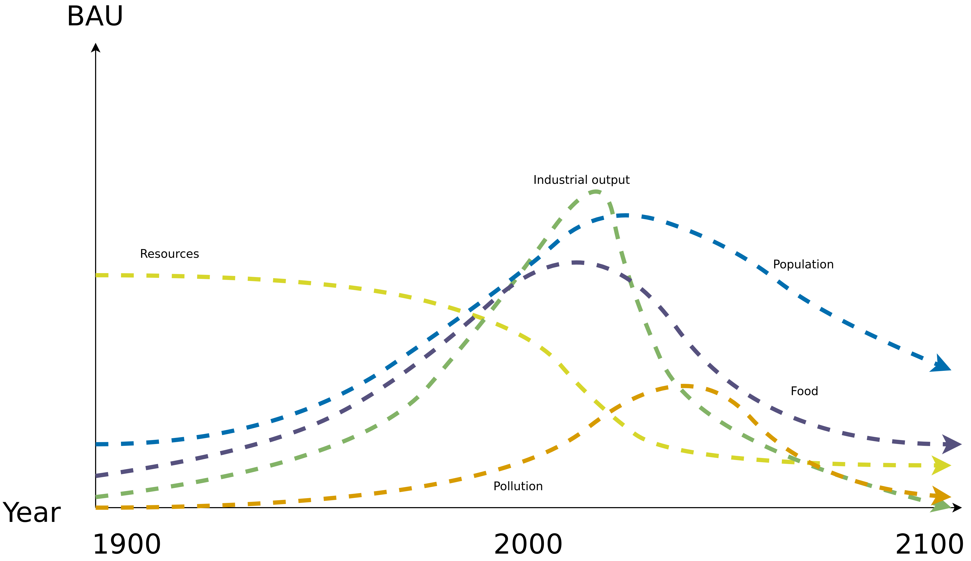
LTG Recap
World3 Standard Run – Business-as-Usual (BAU)
Image recreated from: Gaya Herrington (2020) – Update to limits to growth: Comparing the World3 model with empirical data – Link

Slide 27
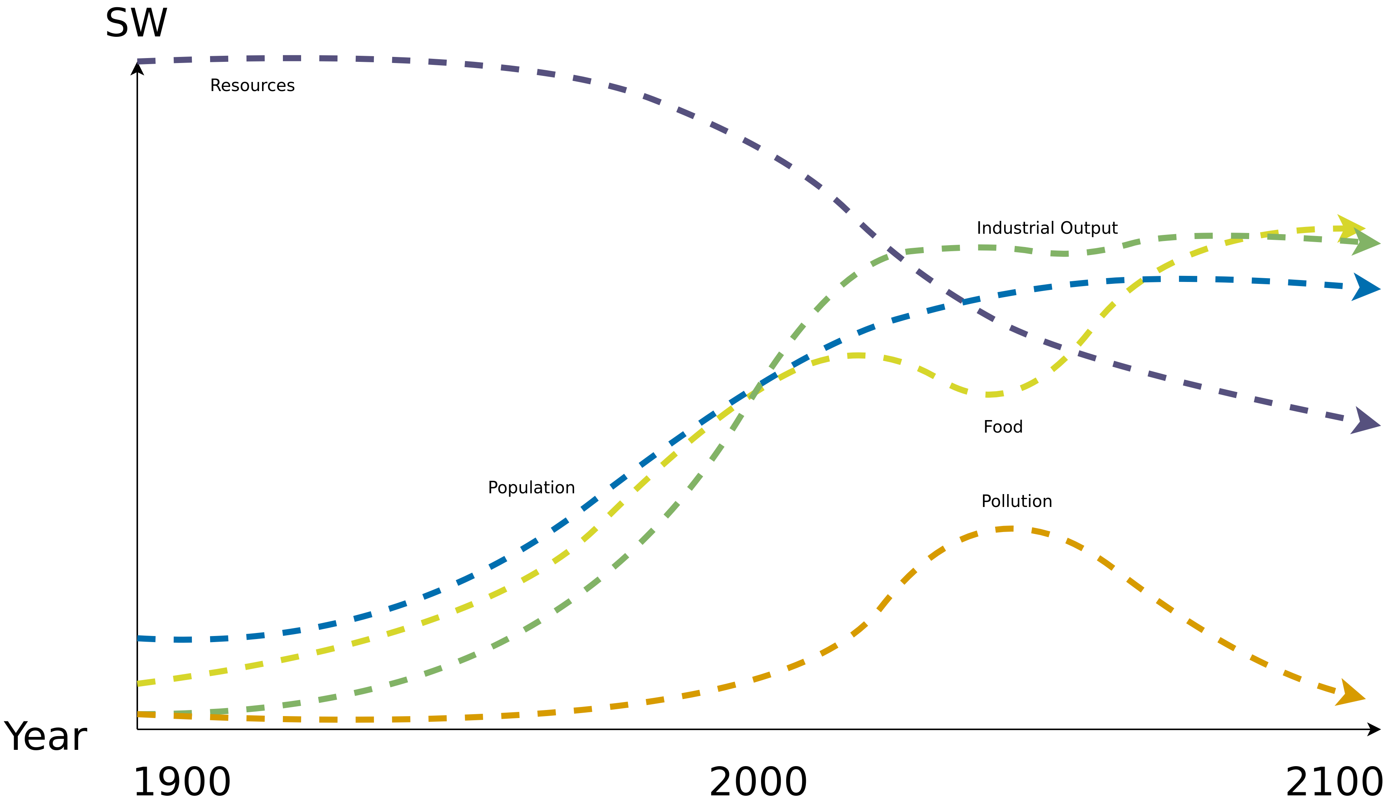
LTG Recap
World3 – Stabilized World (SW)
→ Population stabilizes in the twenty-first century, as does human welfare on a high level
Image recreated from: Gaya Herrington (2020) – Update to limits to growth: Comparing the World3 model with empirical data – Link

Slide 28
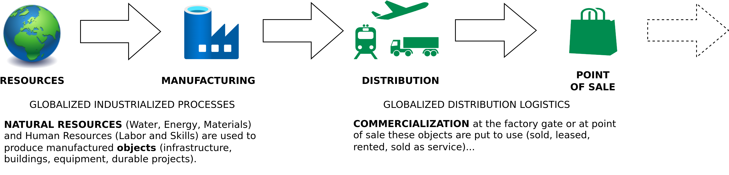
LTG Recap
Linear (Industrial) Economy
Image adapted from: Walter R. Stahel (2019) – The Circular Economy: A User’s Guide.

Slide 29
LTG Recap
Linear Economy – In A Nutshell
“Take – Make – Dispose”
“Its objectives are to maintain value (not to create value added), to optimise stock management (not flows) and to increase the efficiency of using goods (not of producing goods)”

Slide 30
LTG Recap
Linear Economy – In A Nutshell / Definition
“Take – Make – Dispose”
“Its objectives are to maintain value (not to create value added), to optimise stock management (not flows) and to increase the efficiency of using goods (not of producing goods)”
Walter R. Stahel (2019) – The Circular Economy: A User’s Guide.

Slide 31
LTG Recap
Waste Is A Human Concept
Waste = Inefficiency

Slide 32
LTG Recap
Circular Economy
Center for Digital Technologies (DIGIT) (2022) – https://www.digit-research.de/fileadmin/DIGIT/Presse_und_News/Downloads/Grafikpaket_Reallabor_DCE_Kreislaufmodell_V2_ccby.zip – CC BY 4.0.

Slide 33
LTG Recap
Circular (Industrial) Economy – Definition
“The circular industrial economy manages stocks of manufactured assets, such as infrastructure, buildings, vehicles, equipment and consumer goods, to maintain their value and utility as high as possible for as long as possible; and stocks of resources at their highest purity and value.”
Walter R. Stahel (2019) – The Circular Economy: A User’s Guide.

Slide 34

LTG Recap
Performance Economy – Definition
Image adapted from Walter R. Stahel (2019) – The Circular Economy: A User’s Guide.

Slide 35
LTG Recap
Performance Economy – Definition
„The Performance Economy sells results instead of objects. Its economic actors may be manufacturers of durable objects or fleet managers operating them. In both cases, they sell the use of these objects as a service over the longest possible period of time and maximize their profits by exploiting both efficiency and sufficiency solutions. “
Walter R. Stahel (2019) – The Circular Economy: A User’s Guide.

Slide 36
LTG Recap
Sustainability – Definition
„Development that meets the needs of the present without compromising the ability of future generations to meet their own needs.”
Report of the World Commission on Environment and Development: Our Common Future (1987) – http://www.un-documents.net/our-common-future.pdf

Slide 37
LTG Recap
Sustainability – Implication
Sustainability → Consume less

Slide 38
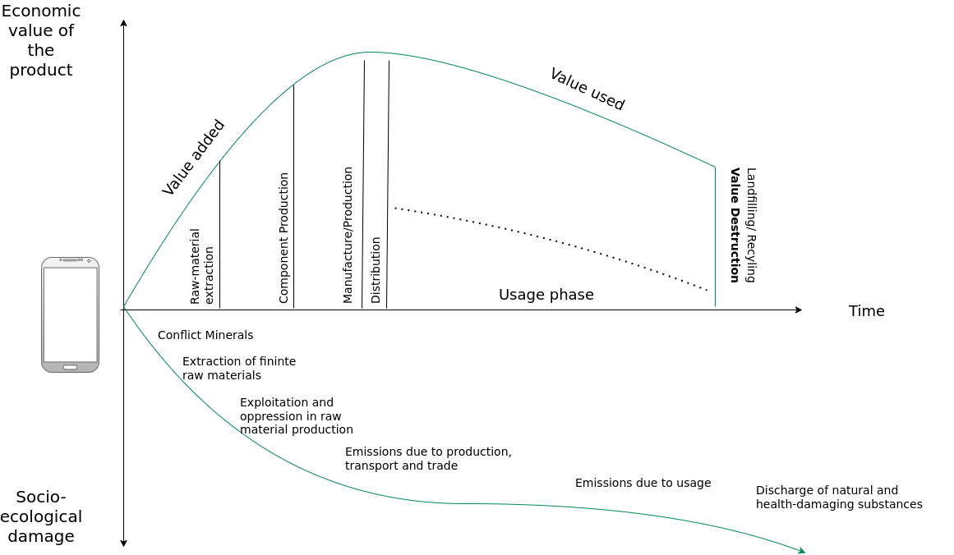
LTG Recap
Circular Society – CE Criticism
Image adapted from: M. Jaeger-Erben, F. Hofmann (2019) – Kreislaufwirtschaft - Ein Ausweg aus der sozial-ökologischen Krise? – Link.

Slide 39
LTG Recap
Circular Society – CE Criticism
Replace the LE with circularly oriented forms of consumption and production
CE focus mostly on earned value management (“Wertschöpfungsmanagement”), product-service systems, product/business model innovations within existing power asymmetries
Decouple economic growth and consumption of natural resources
→ But why do we need never ending economic growth and why is it good to consume as many goods and services as possible?
Alternatives:
Sufficiency strategies and lifestyle changes
Question the prevailing entrepreneurial orientation towards the shareholder concept
Deconstruction of existing power and hegemonic relations
Partially based on: F. Hofmann, J. Zwiers (2018) – Circular Society – Eine pluralistische und emanzipatorische Alternative zur Circular Economy? – Link.
.

Slide 40
LTG Recap
Circular Society – CE Criticism
Replace the LE with circularly oriented forms of consumption and production
CE focus mostly on earned value management (“Wertschöpfungsmanagement”), product-service systems, product/business model innovations within existing power asymmetries
Decouple economic growth and consumption of natural resources
→ But why do we need never ending economic growth and why is it good to consume as many goods and services as possible?
Alternatives:
Sufficiency strategies and lifestyle changes
Question the prevailing entrepreneurial orientation towards the shareholder concept
Deconstruction of existing power and hegemonic relations
Partially based on: F. Hofmann, J. Zwiers (2018) – Circular Society – Eine pluralistische und emanzipatorische Alternative zur Circular Economy? – Link.
.

Slide 41
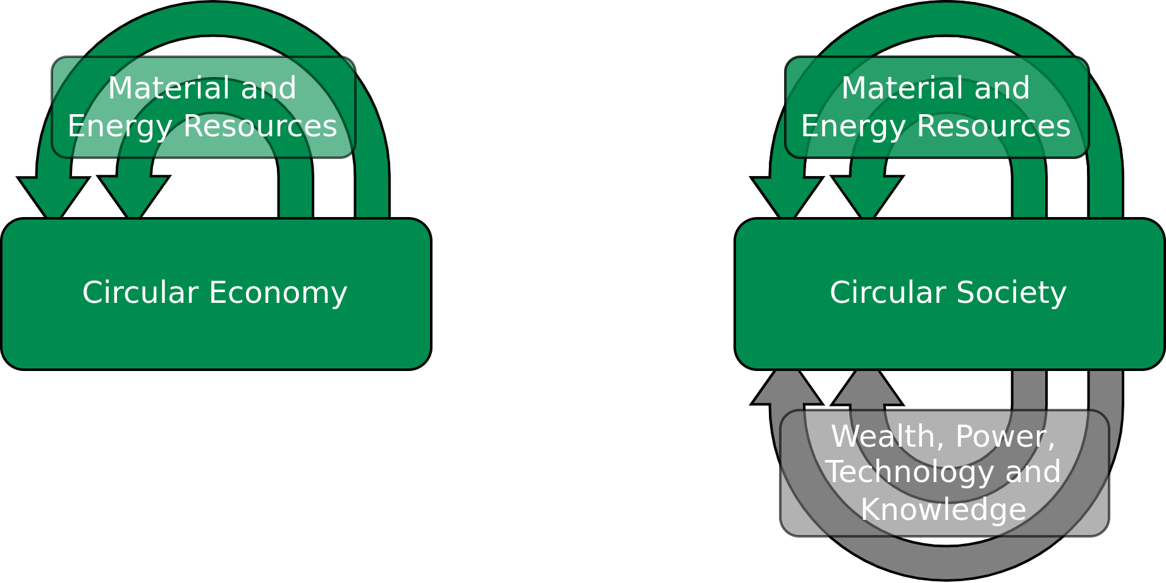
LTG Recap
Circular Society – Definition
„ A circular society defines discourses with a vision of circularity where not only resources are circulated in sustainable loops, but also wealth, knowledge, technology and power is
circulated and redistributed throughout society”
Image licensed under CC BY-SA 4.0, sourced from M. C. Friant, R. Salomone, W. J. V. Vermeulen (2020) – A Typology of Circular Economy Discourses: Navigating the Diverse Visions of a Contested Paradigm – Link

Slide 42
LTG Recap
CS and CE Perspectives
Image recreated from: M. C. Friant, R. Salomone, W. J. V. Vermeulen (2020) – A Typology of Circular Economy Discourses: Navigating the Diverse Visions of a Contested Paradigm – Link

Slide 43
LTG Recap
Technology – Quick Fix?
Image recreated from: M. C. Friant, R. Salomone, W. J. V. Vermeulen (2020) – A Typology of Circular Economy Discourses: Navigating the Diverse Visions of a Contested Paradigm – Link

Slide 44
Recap – What is this Course About

Slide 45
LTG Recap
What Is This Course All About?
Gaining an understanding of causes, dimensions, and the characterization of the 3 key challenge of the 21st century
Climate change / adaption to climate change
Environmental pollution
Dwindling non-renewable resources
Critically assess available solutions
Act before it is to late

Slide 46
LTG Recap
What Is This Course All About?
Gaining an understanding of causes, dimensions, and the characterization of the 3 key challenge of the 21st century
Climate change / adaption to climate change
Environmental pollution
Dwindling non-renewable resources
Critically assess available solutions
Act before it is to late

Slide 47
LTG Recap
What Is This Course All About?
Gaining an understanding of causes, dimensions, and the characterization of the 3 key challenge of the 21st century
Climate change / adaption to climate change
Environmental pollution
Dwindling non-renewable resources
Critically assess available solutions
Act before it is to late

Slide 48
LTG Recap
What Is This Course All About?
This course is supposed to enable YOU to create a sustainable future for all of us and future generations.

Slide 49
LTG Recap
What Is This Course All About? – Strategy
Strategy is “turning resources you have into the power you need to get what you want
→ your goal. [Marshall Ganz]
Strategic Goal (what you want): The goal is a clear, measurable point that allows you to know if you’ve won or lost, and that meets the challenge your constituency faces.
Power (what you need): tactics through which you can turn your resources into the capacity you need to achieve your goal.
Resources (what your constituency has): time, money, skills, relationships, etc.

Slide 50
Act Now

Slide 51
Act Now
Image recreated from: M. C. Friant, R. Salomone, W. J. V. Vermeulen (2020) – A Typology of Circular Economy Discourses: Navigating the Diverse Visions of a Contested Paradigm – Link

Slide 52
Act Now
Courage
“But the opposite of hope is not despair. It is grief. Even while resolving to limit the damage, we can mourn. And here, the sheer scale of the problem provides a perverse comfort: we are in this together. The swiftness of the change, its scale and inevitability, binds us into one, broken hearts trapped together under a warming atmosphere.
We need courage, not hope. Grief, after all, is the cost of being alive. [...] Courage is the resolve to do well without the assurance of a happy ending.”
Kate Marvel (2018) – We Need Courage, Not Hope, to Face Climate Change – https://onbeing.org/blog/kate-marvel-we-need-courage-not-hope-to-face-climate-change/

Slide 53
Act Now
Minimize/Avoid Waste – Waste Is A Human Concept
Waste = Inefficiency

Slide 54
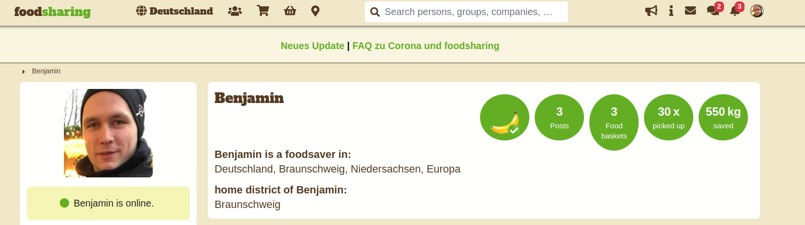
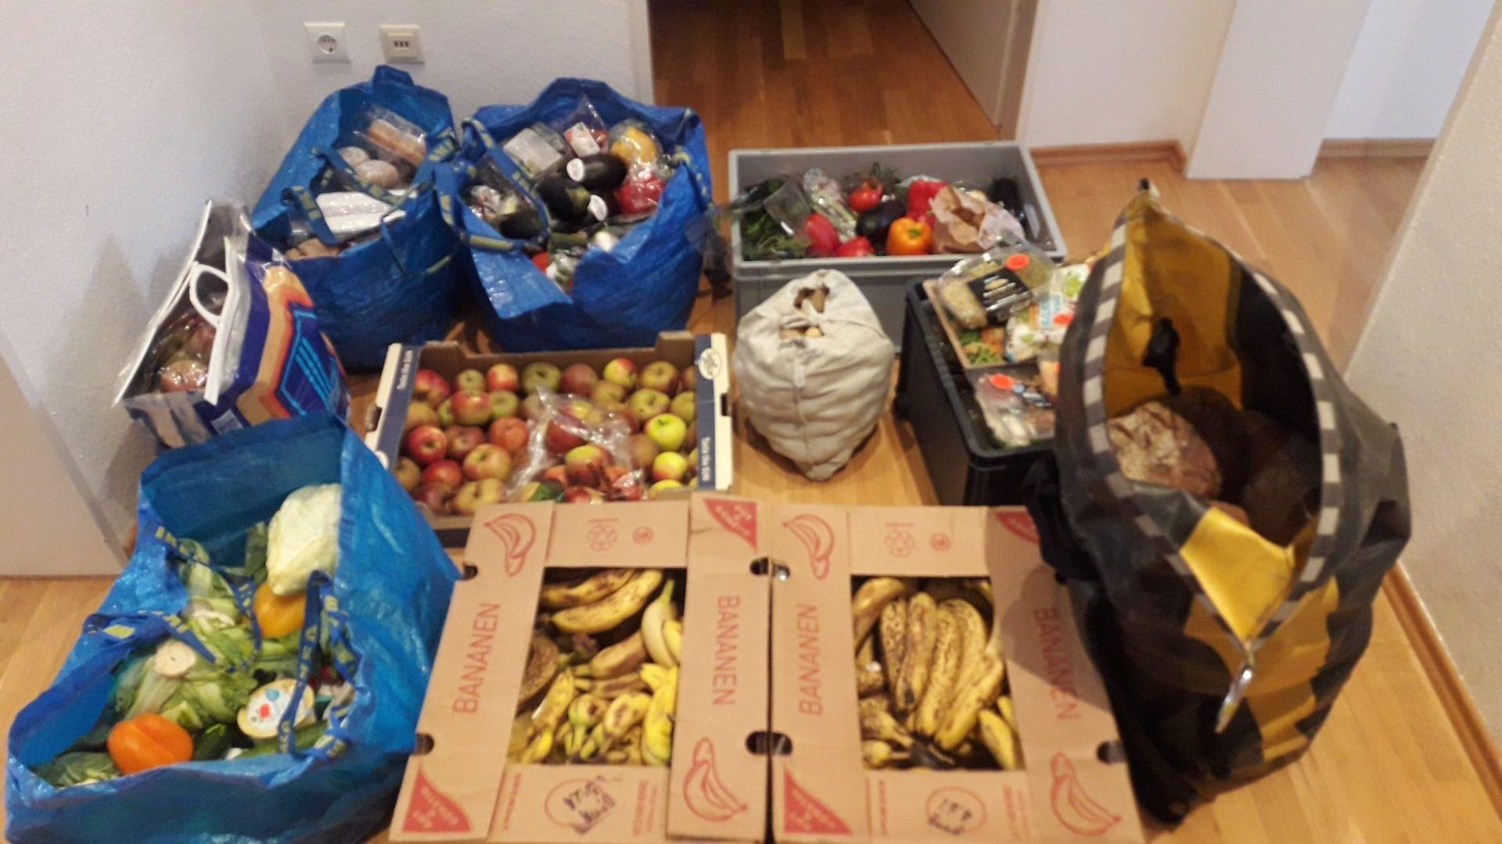
Act Now
Minimize/Avoid Waste – Foodsharing
https://foodsharing.de/

Slide 55
Act Now
Minimize/Avoid Waste – General
Taking responsibility (being accountable) for the trash/wast that you create and the resources you consume
What is left after you consumed the product/service?
Does it generate, or result in trash/waste?
Can you reuse it in any other way thereby avoiding trash?
Is the generated waste, the implicit/explicit environmental pollution, the used resources, and so on worth the short term pleasure?
Zero-waste might be unrealistic
Instead → Reduce your footprint (no only carbon) as much as possible
Resources, energy, pollution, emissions, etc.
Act before it is to late

Slide 56
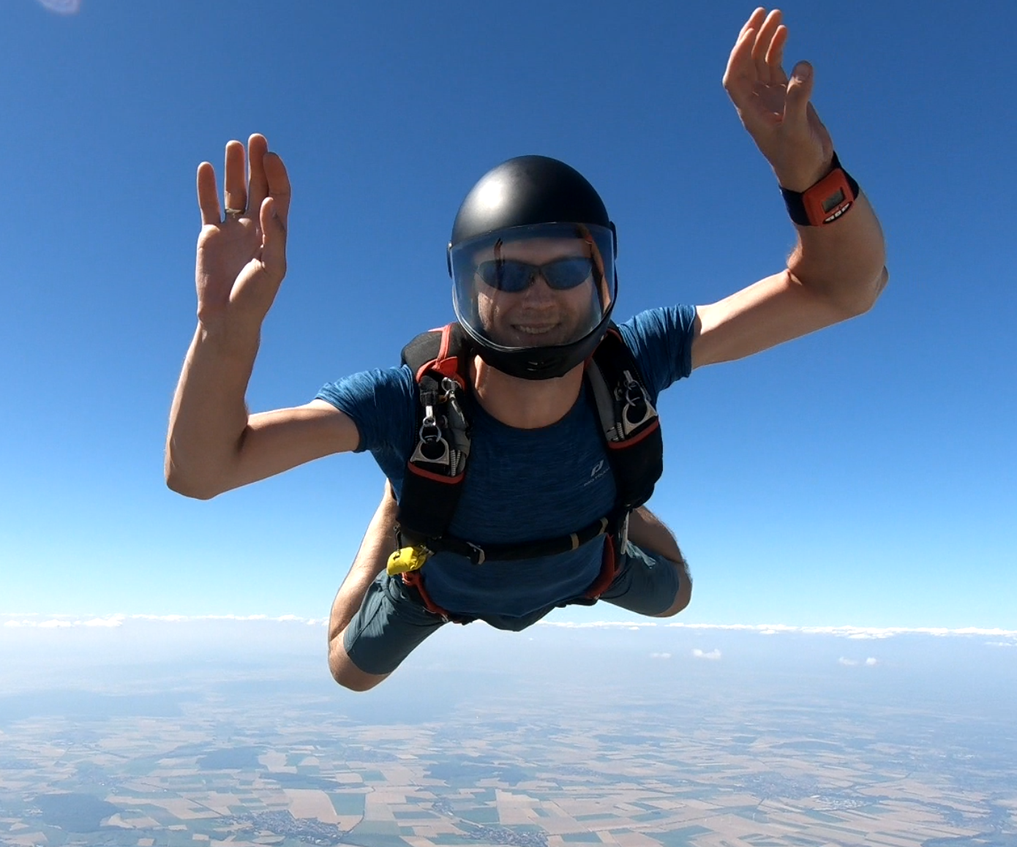
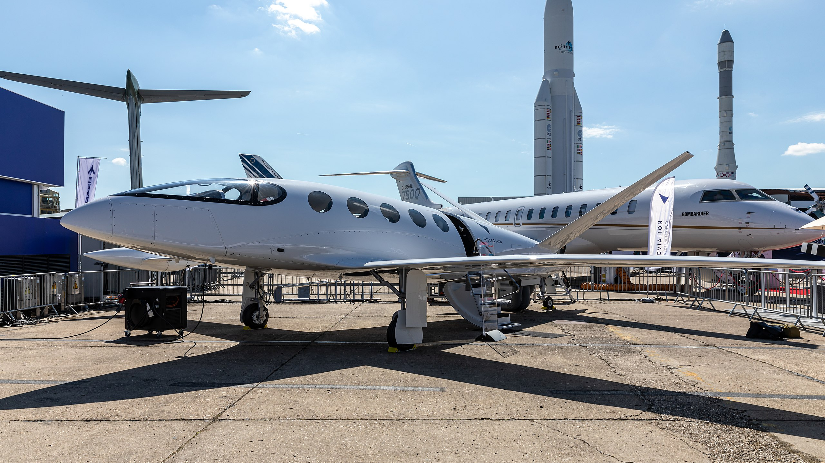
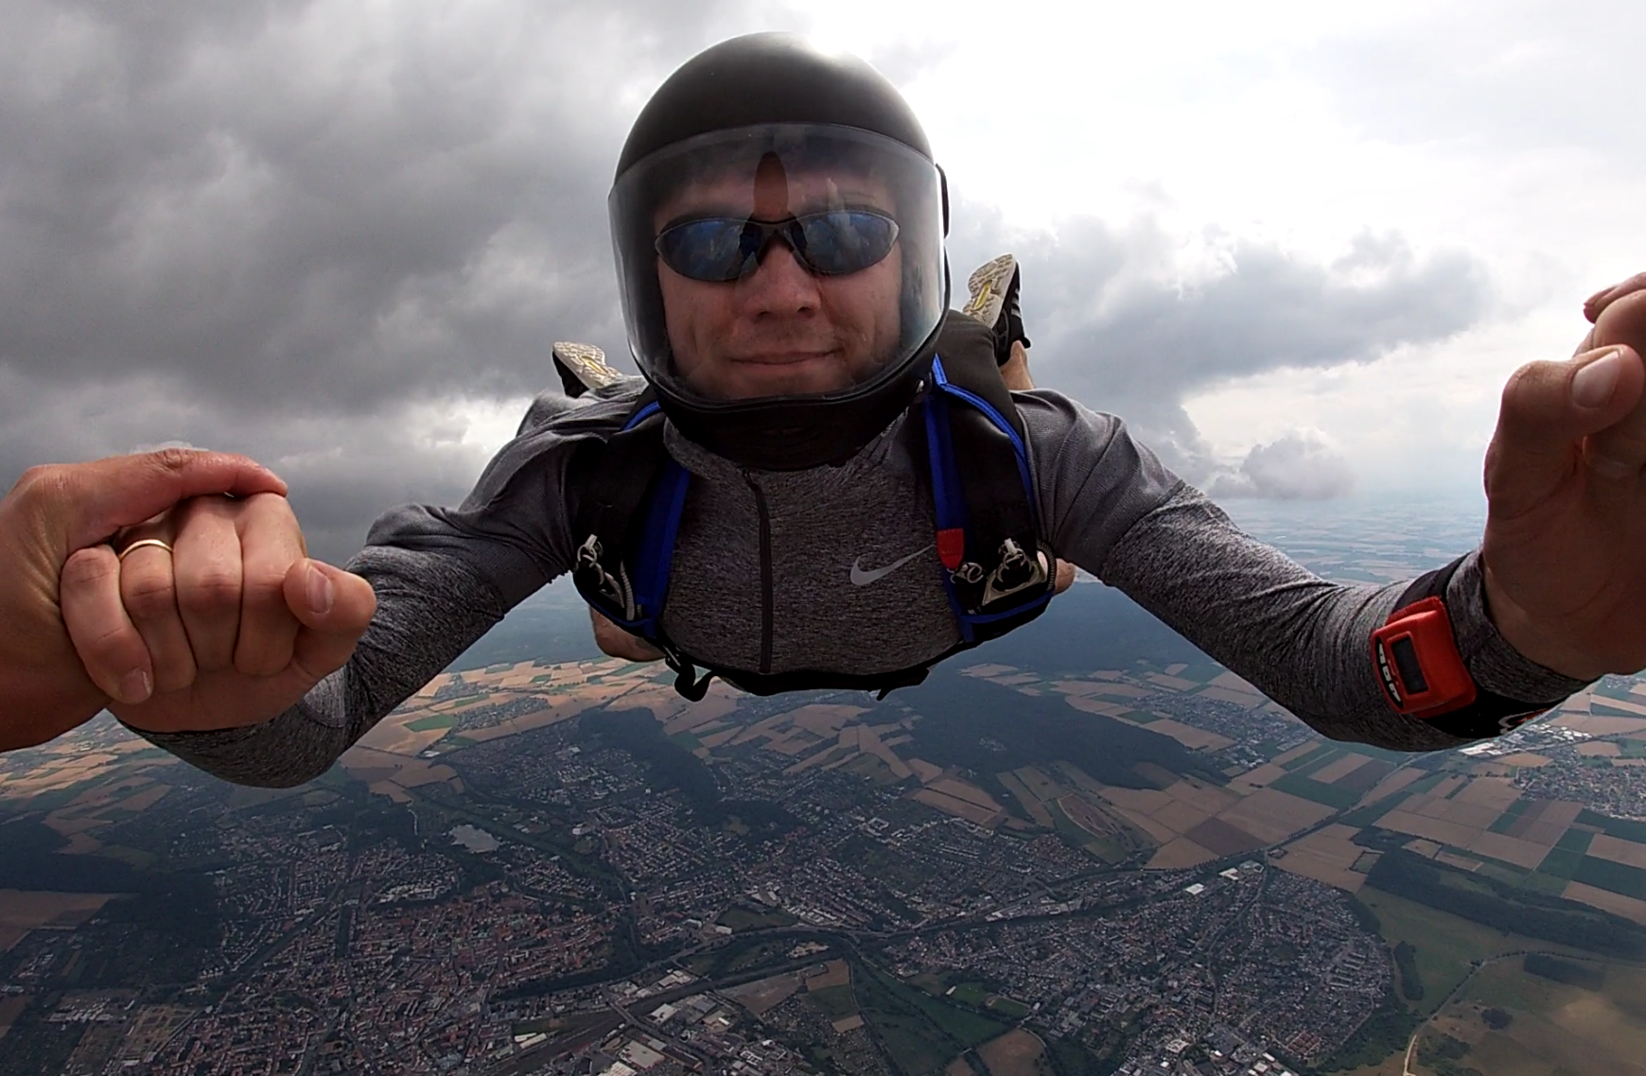
Act Now
Minimize Your Footprint
1.Matti Blume – https://upload.wikimedia.org/wikipedia/commons/b/ba/Eviation_Alice%2C_Paris_Air_Show_2019%2C_Le_Bourget_%28SIAE8856%29.jpg – CC BY-SA 4.0
2.Benjamin Leiding – CC BY-SA 4.0.

Slide 57
Act Now
Minimize Your Footprint
1.Matti Blume – https://upload.wikimedia.org/wikipedia/commons/b/ba/Eviation_Alice%2C_Paris_Air_Show_2019%2C_Le_Bourget_%28SIAE8856%29.jpg – CC BY-SA 4.0
2.Benjamin Leiding – CC BY-SA 4.0.

Slide 58
Act Now
Minimize Your Footprint – Sustainability
Sustainability → Consume less

Slide 59
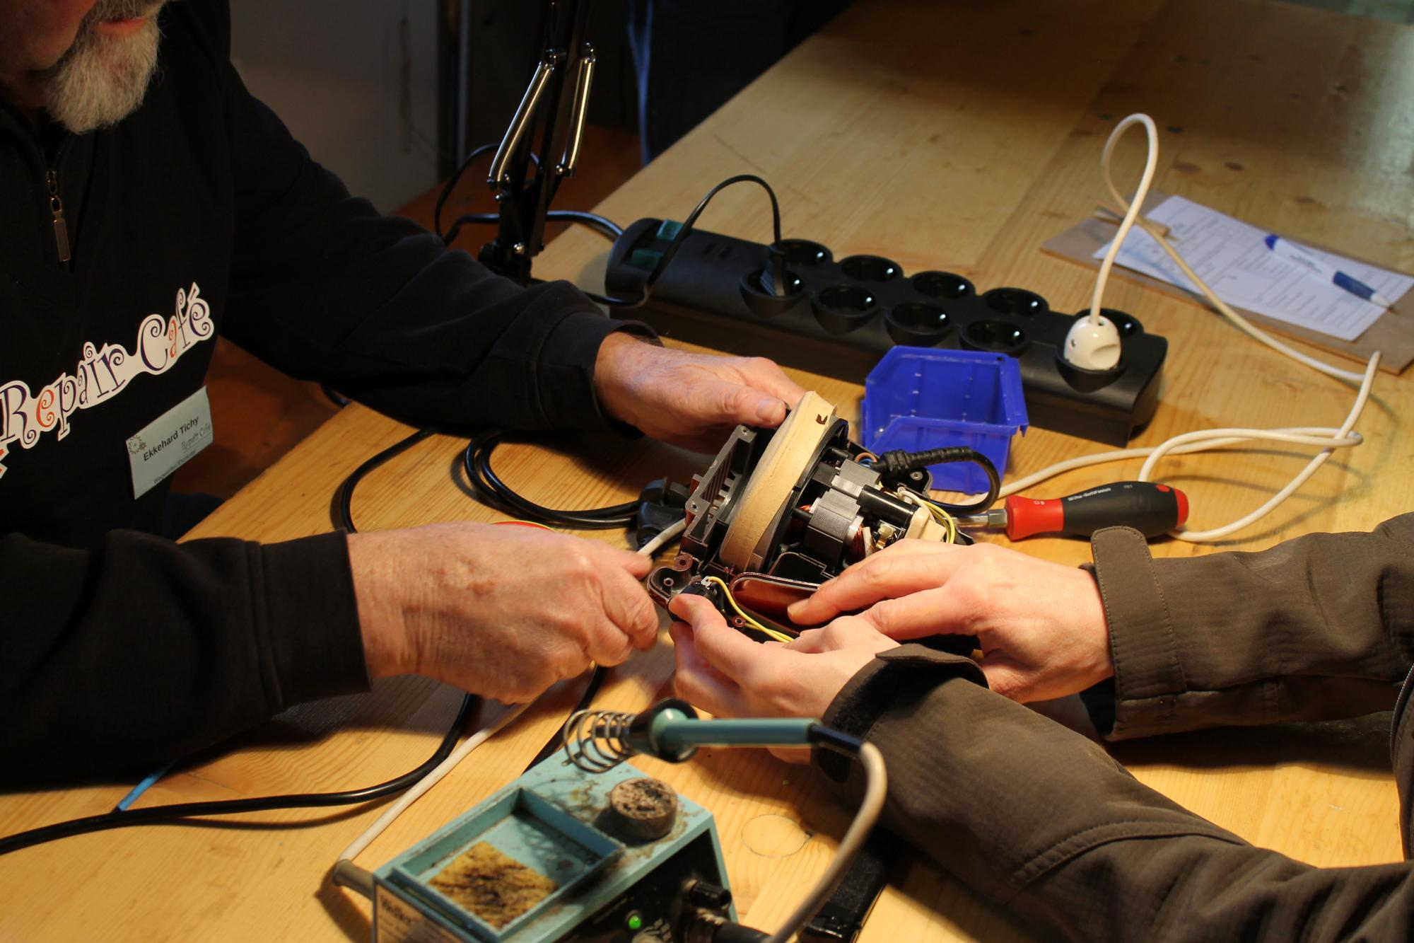
Act Now
Minimize Your Footprint – Repair Cafe / Sharing / 2nd Hand
1. RaMa2016 – https://upload.wikimedia.org/wikipedia/commons/1/17/Repair_Caf%C3%A9_Trier_Reparatur.jpg – CC BY-SA 4.0
2. Ibrahim Husain Meraj – https://upload.wikimedia.org/wikipedia/commons/9/96/Various_tools_for_cycle_repair_01.jpg – CC BY-SA 4.0
3. Janne Hellsten – https://upload.wikimedia.org/wikipedia/commons/e/e3/Brand_new_second_hand.jpg – CC BY 2.0

Slide 60
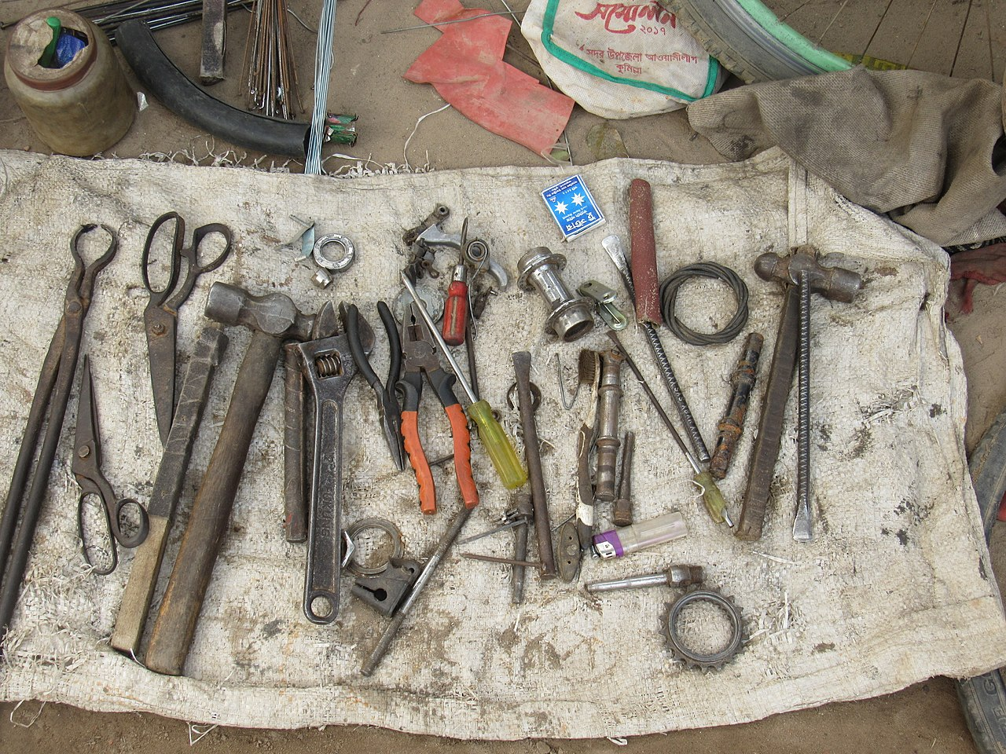
Act Now
Minimize Your Footprint – Repair Cafe / Sharing / 2nd Hand
1. RaMa2016 – https://upload.wikimedia.org/wikipedia/commons/1/17/Repair_Caf%C3%A9_Trier_Reparatur.jpg – CC BY-SA 4.0
2. Ibrahim Husain Meraj – https://upload.wikimedia.org/wikipedia/commons/9/96/Various_tools_for_cycle_repair_01.jpg – CC BY-SA 4.0
3. Janne Hellsten – https://upload.wikimedia.org/wikipedia/commons/e/e3/Brand_new_second_hand.jpg – CC BY 2.0

Slide 61
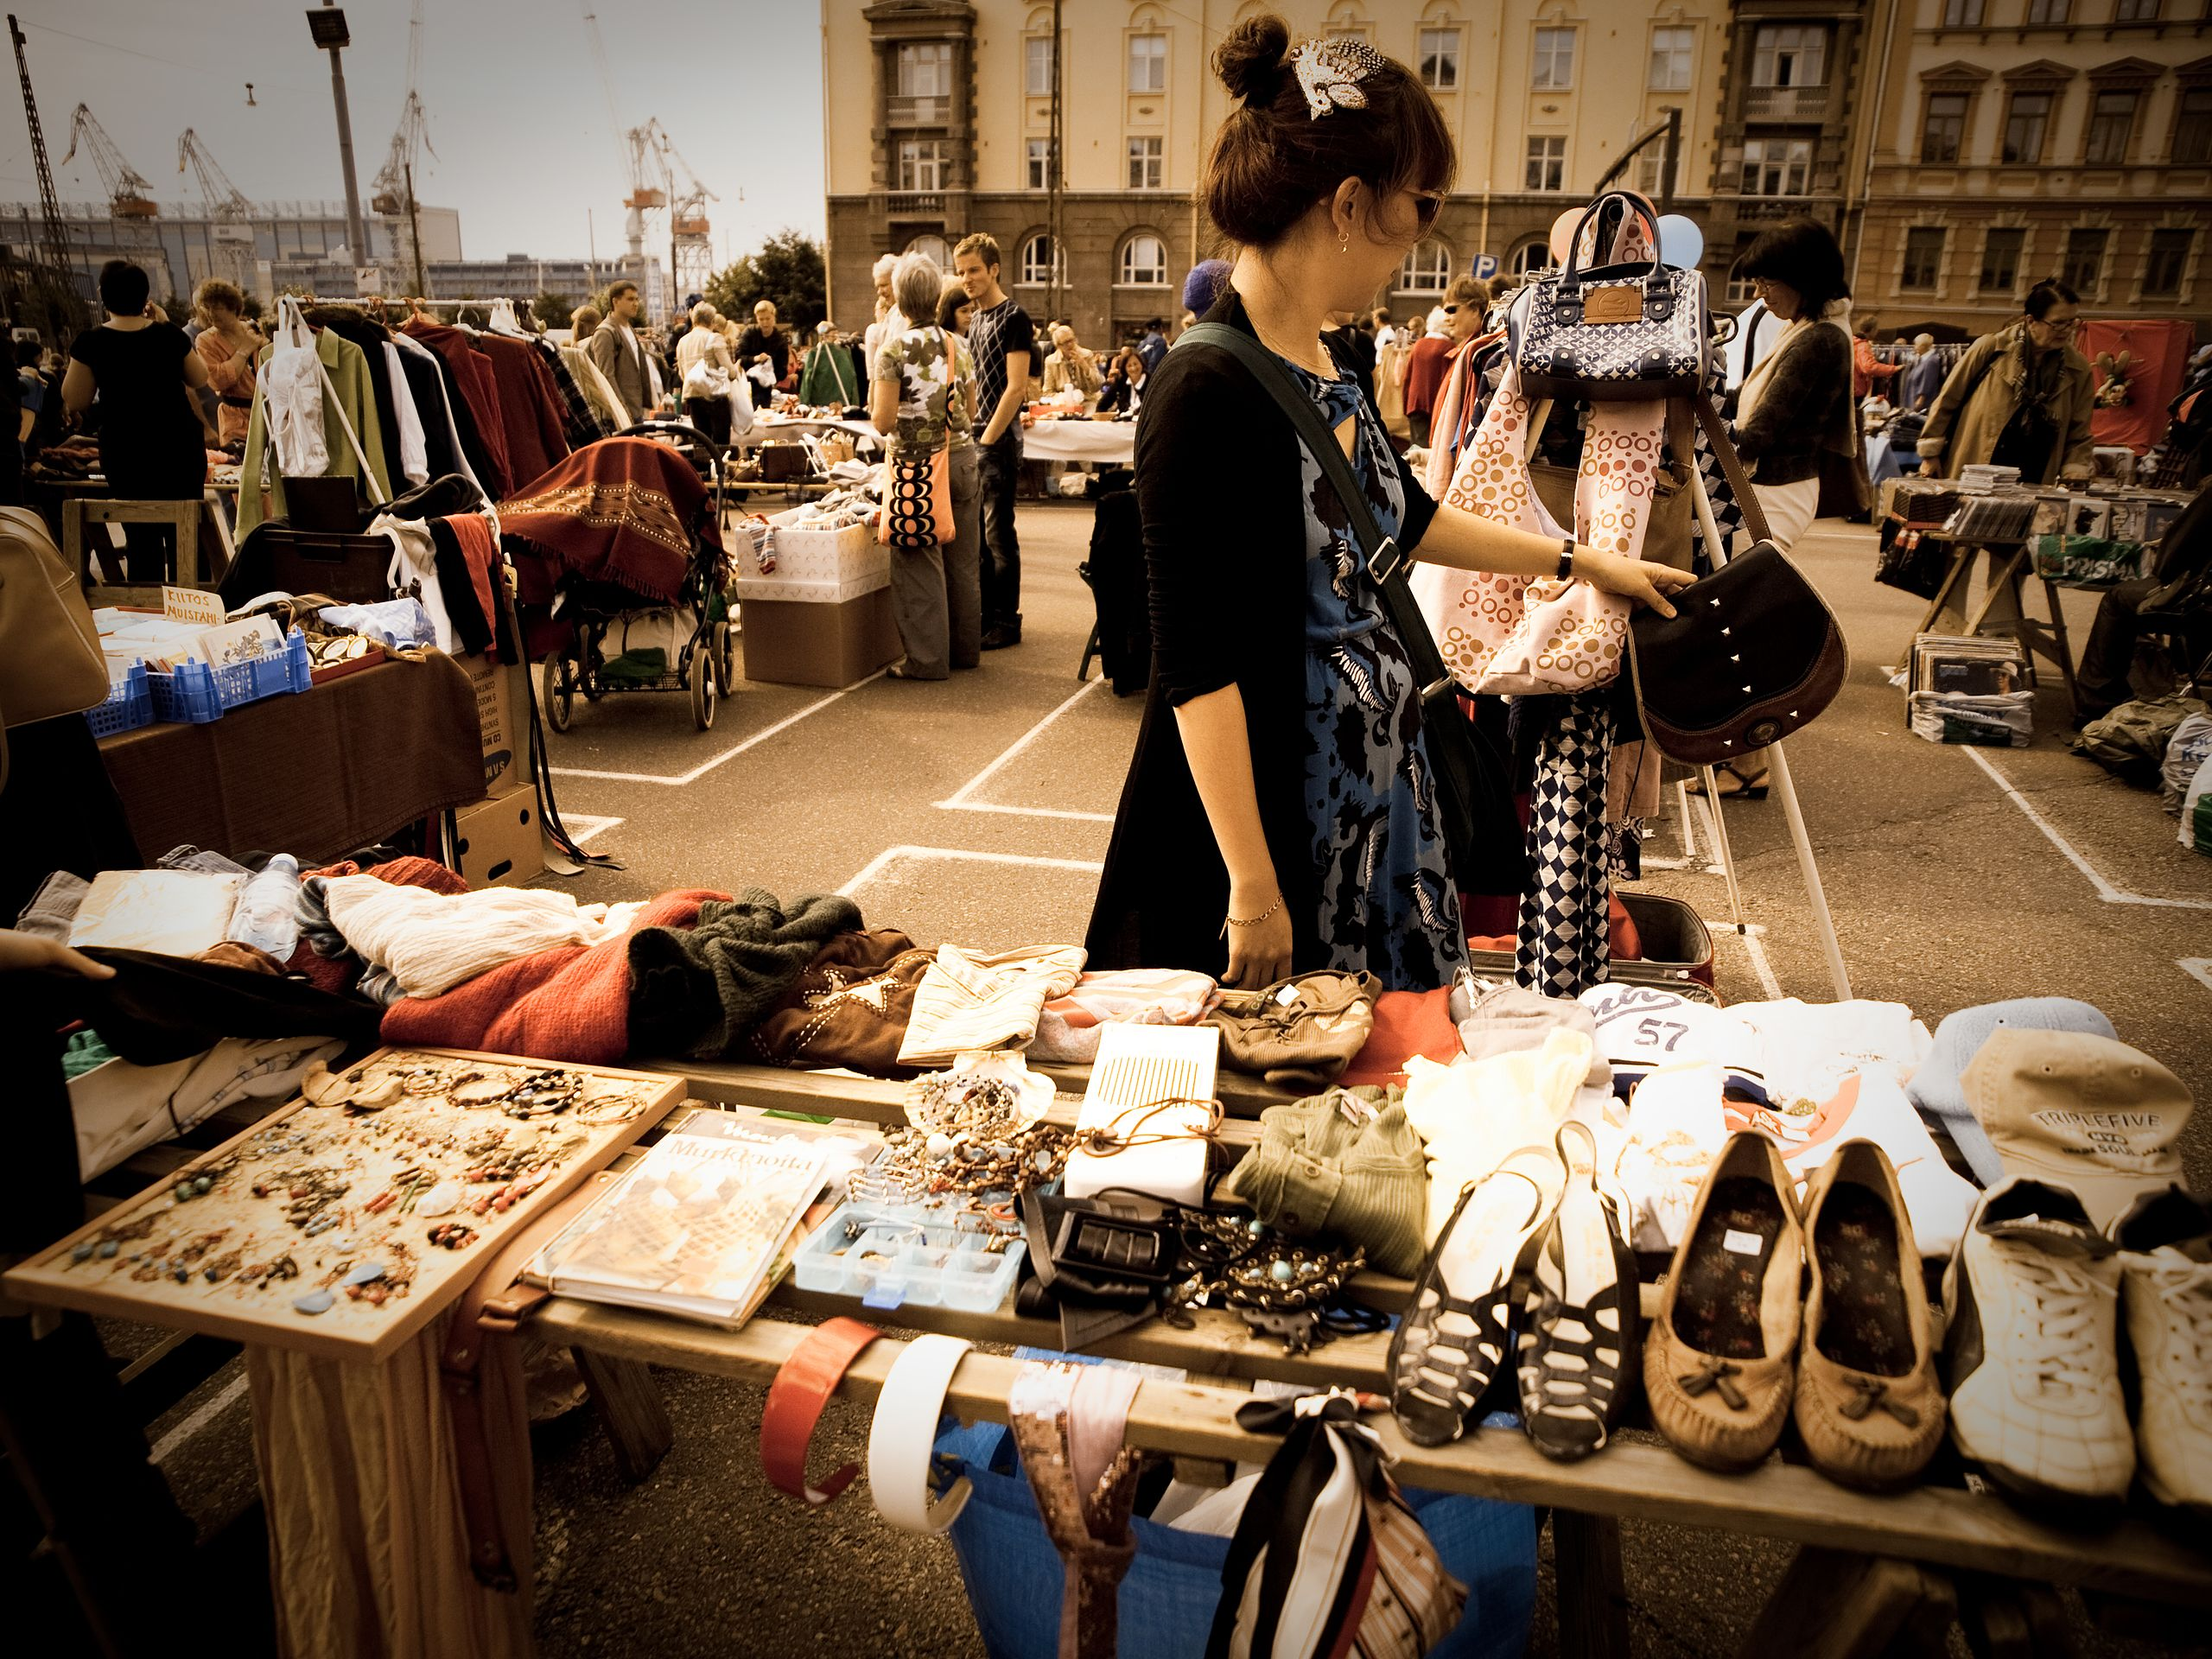
Act Now
Minimize Your Footprint – Repair Cafe / Sharing / 2nd Hand
1. RaMa2016 – https://upload.wikimedia.org/wikipedia/commons/1/17/Repair_Caf%C3%A9_Trier_Reparatur.jpg – CC BY-SA 4.0
2. Ibrahim Husain Meraj – https://upload.wikimedia.org/wikipedia/commons/9/96/Various_tools_for_cycle_repair_01.jpg – CC BY-SA 4.0
3. Janne Hellsten – https://upload.wikimedia.org/wikipedia/commons/e/e3/Brand_new_second_hand.jpg – CC BY 2.0

Slide 62
Act Now
Climate-Resilient Food Production
Agroforestry → Trees/shrubs are grown around or among crops or pastureland (Link)
Permaculture → Growth of an agricultural ecosystem in a self-sufficient and sustainable way (Link)
Silvopasture → Trees, forage and domesticated animals in a mutually beneficial way
Etc.

Slide 63
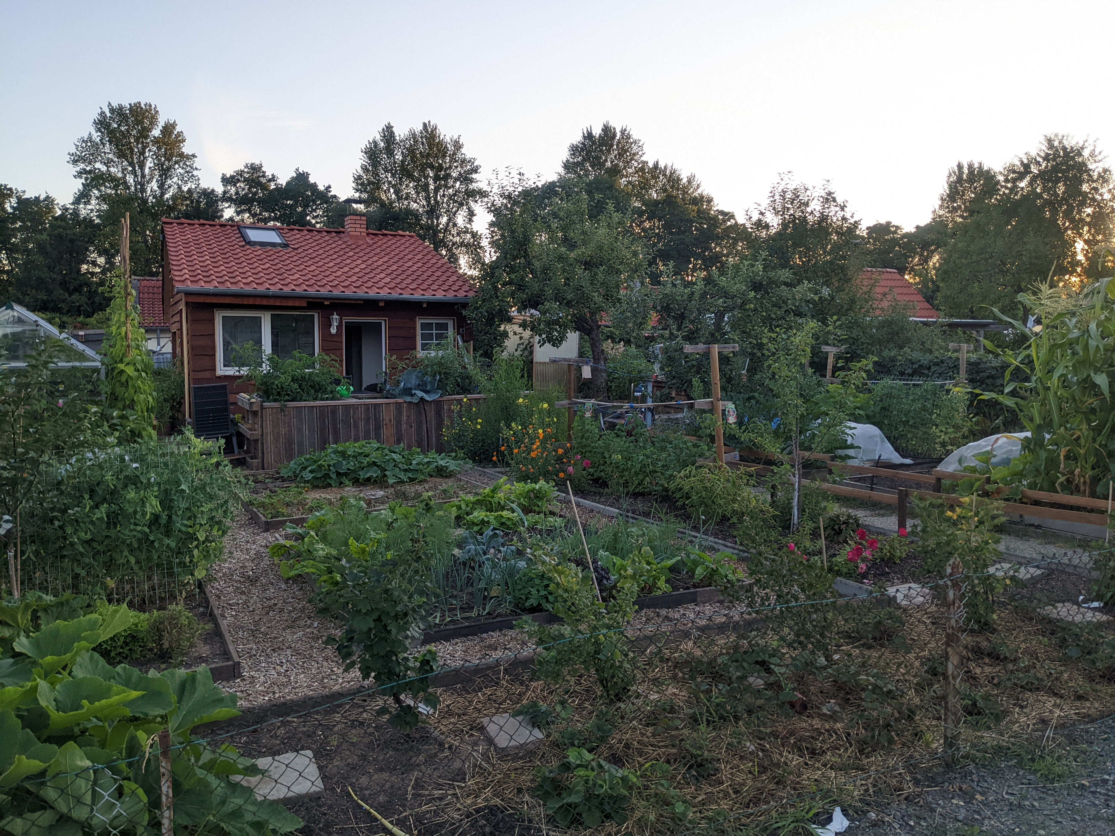
Act Now
Climate-Resilient Food Production – Garden Plot (“Kleingarten”)
Benjamin Leiding – CC BY-SA 4.0.

Slide 64
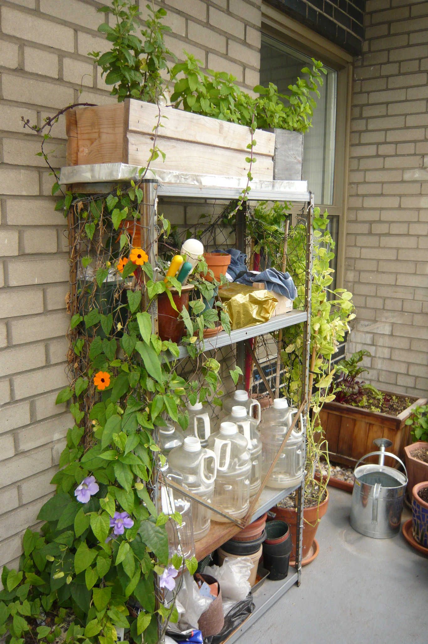
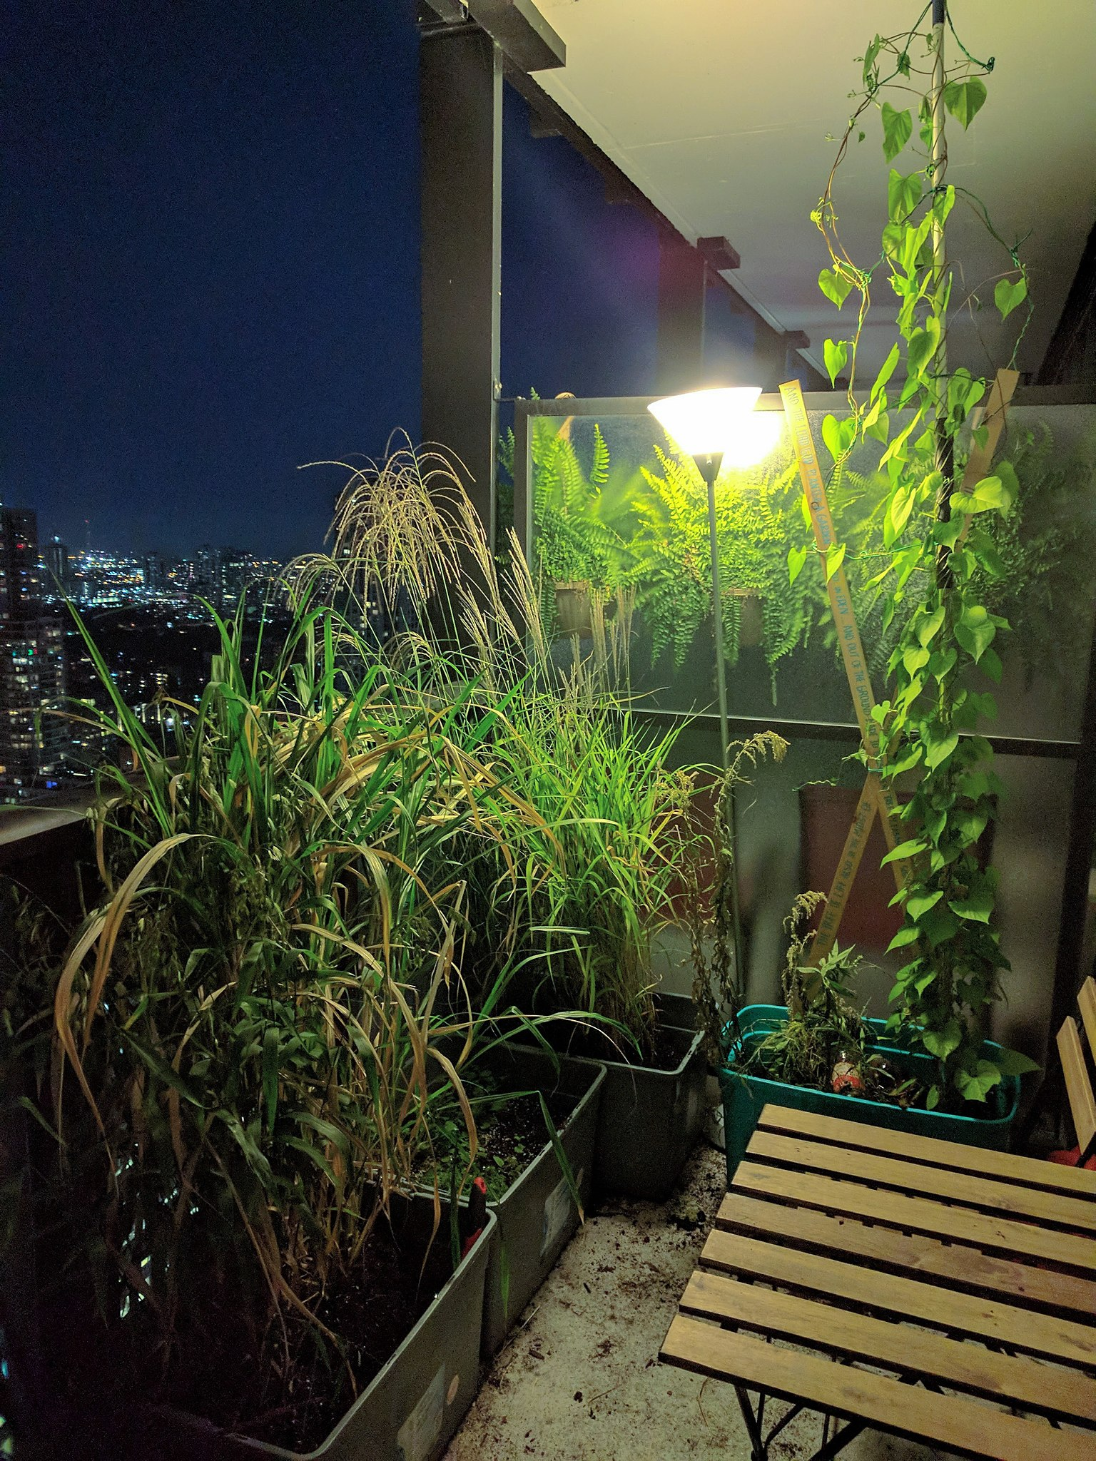
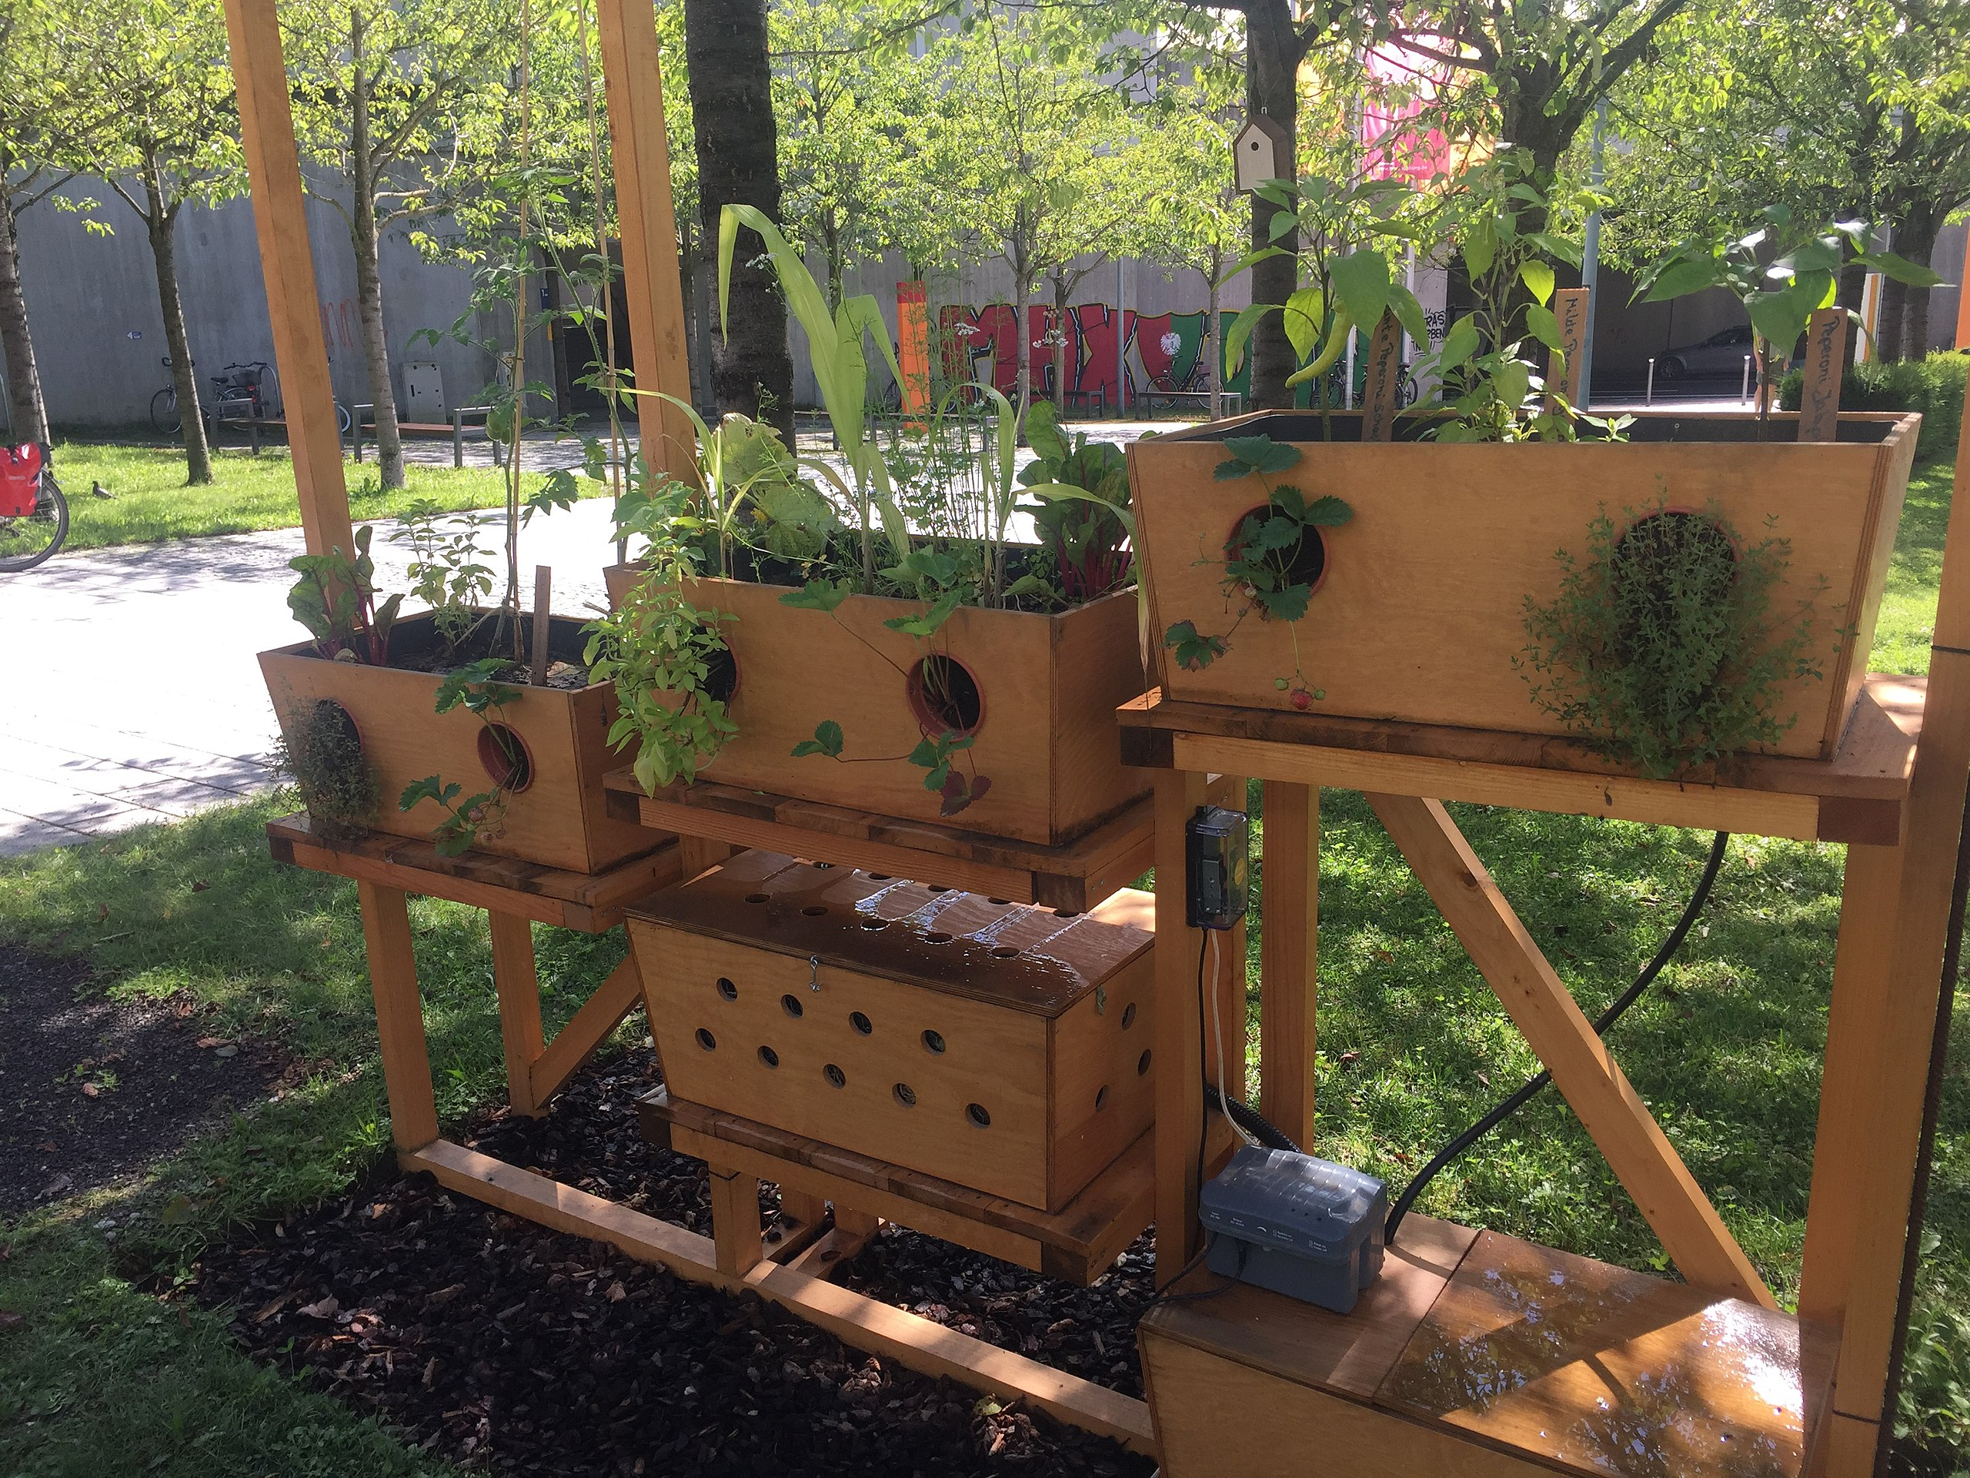
Act Now
Climate-Resilient Food Production – Urban/Balcony Gardening
1. Neitram – https://upload.wikimedia.org/wikipedia/commons/7/71/Urban-Gardening-Demonstrationsgarten_der_Hochschule_Augsburg_01.jpg – CC BY-SA 4.0
2. Bad Alley – https://www.flickr.com/photos/badalley/3727226471 – CC BY-NC-SA 2.0
3. Ecoscapes – https://upload.wikimedia.org/wikipedia/commons/9/9d/Condominium_balcony_container_gardening_at_night.jpg – CC BY-SA 4.0

Slide 65
Act Now
Activism – Fridays for Future / Extinction Rebellion / Etc.
Short history of actions on climate change
Geneva, Kyoto, Copenhagen, Paris, Glasgow, etc.
Problem
→ A lot of bla bla
→ Lack of progress
→ Policies favor business as usual instead of acting in accordance with science because they are afraid to make unpopular decisions
Individual activism as a response / counter movement to inactive governments who ignore urgent issues (i.e., the three key challenges of the 21st century)

Slide 66
Act Now
Activism – Fridays for Future / Extinction Rebellion / Etc.
“Climate activists are sometimes depicted as dangerous radicals, but the truly dangerous radicals are the countries that are increasing the production of fossil fuels.”
United Nations Secretary General Antonio Guterres

Slide 67
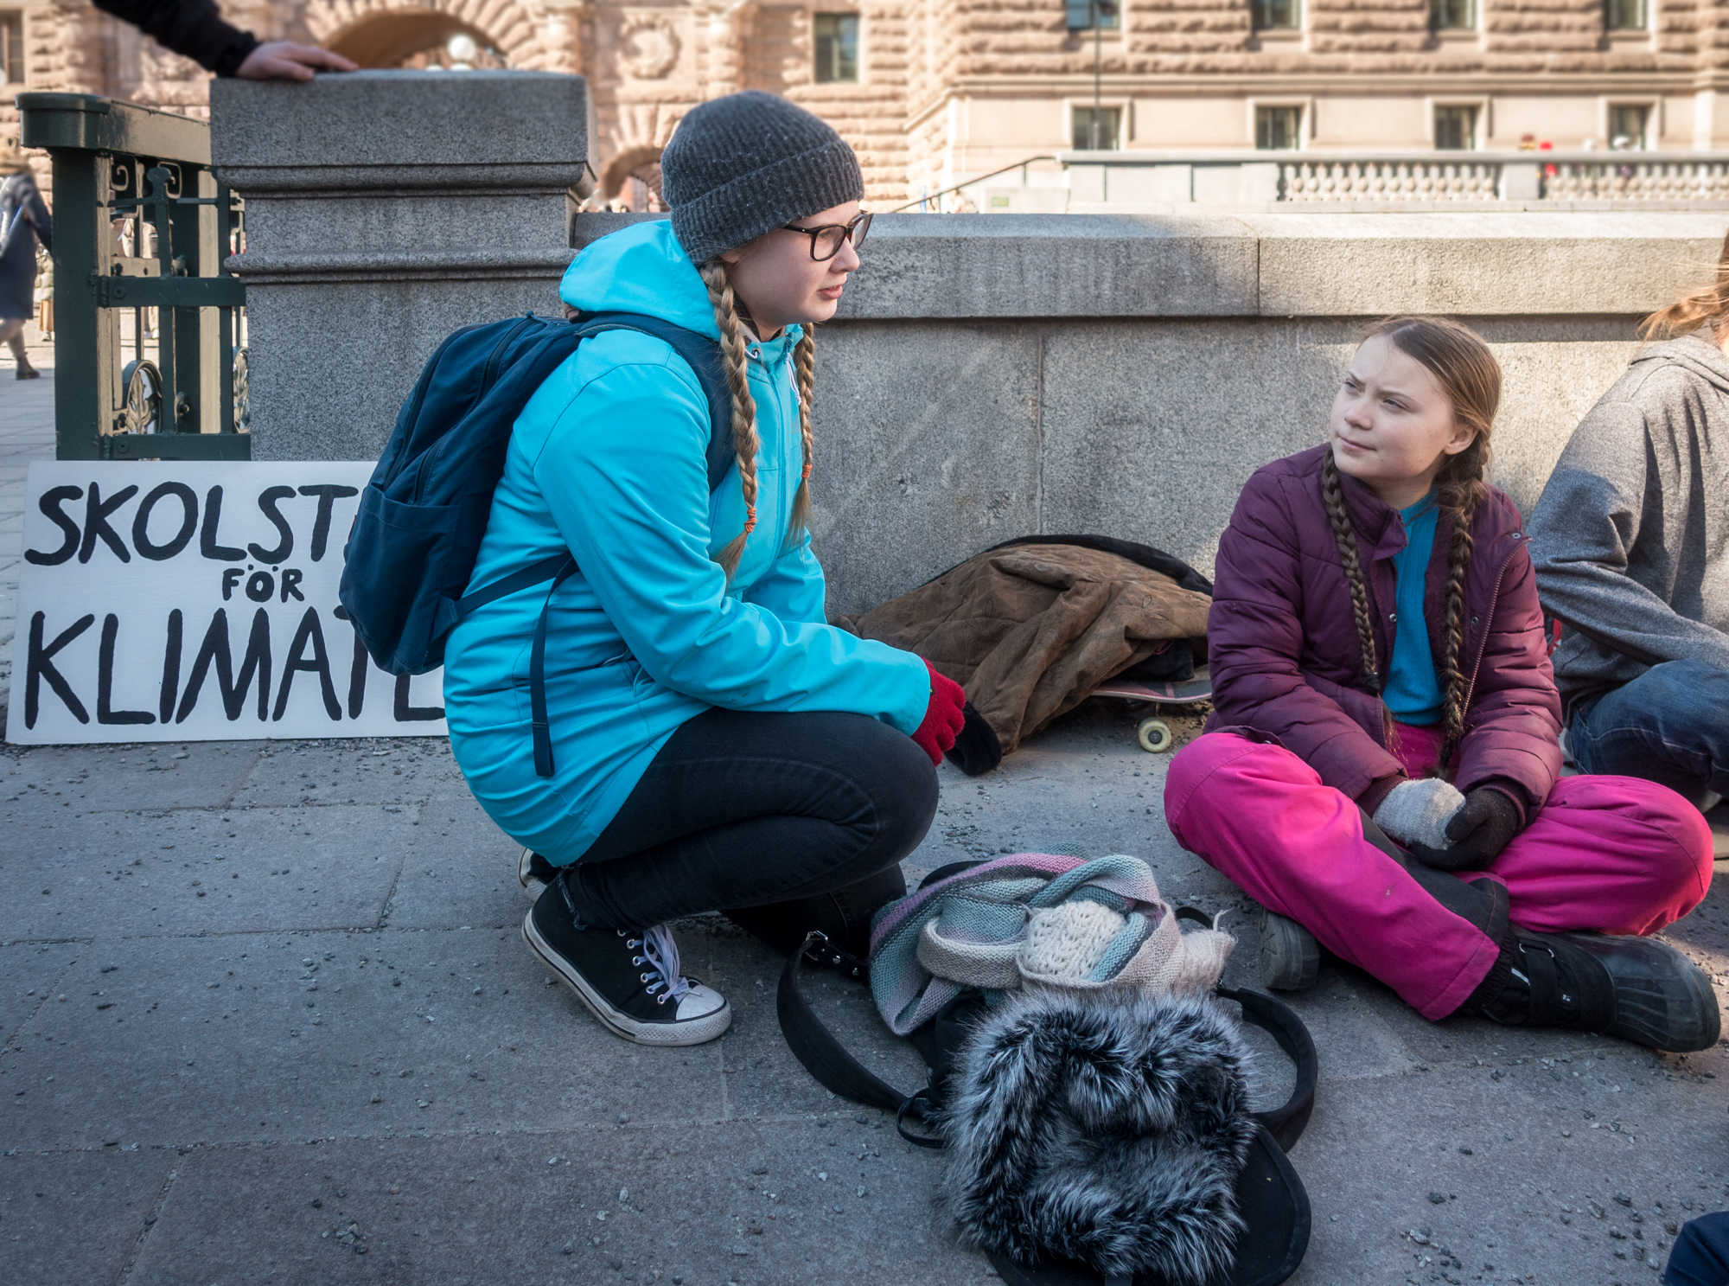
Act Now
Activism – Fridays for Future / Extinction Rebellion / Etc.
Frankie Fouganthin (2019) – https://commons.wikimedia.org/wiki/File:Greta_Thunberg_in_School_strike_for_the_climate.jpg – CC BY-SA 4.0.

Slide 68
Act Now
Activism – Fridays for Future / Extinction Rebellion / Etc.
“I am afraid of losing my child to a resource war because of a climate collapse”
XR Strategiepapier 2022 – Pusteblumen und Hype. Bilder: Sebastian Höhn, Joe Pohl, Sandra Doneck, Alessandro Brönnimann

Slide 69
Act Now
Break Out of the Hamster Wheel
Assumption → Capitalism = pyramid/ponzy scheme
What are alternatives?
Cooperatives
gGmbH (non-profit company with limited liability under German law)
Cooperative comunities
Get a job that does not facilitate an unsustainable use of our planet, i.e., the three key challenges of the 21st century
Go local (local cooperation, local consumption, local money, local sourcing of resources)
Less expenses → less time you need to spend working

Slide 70
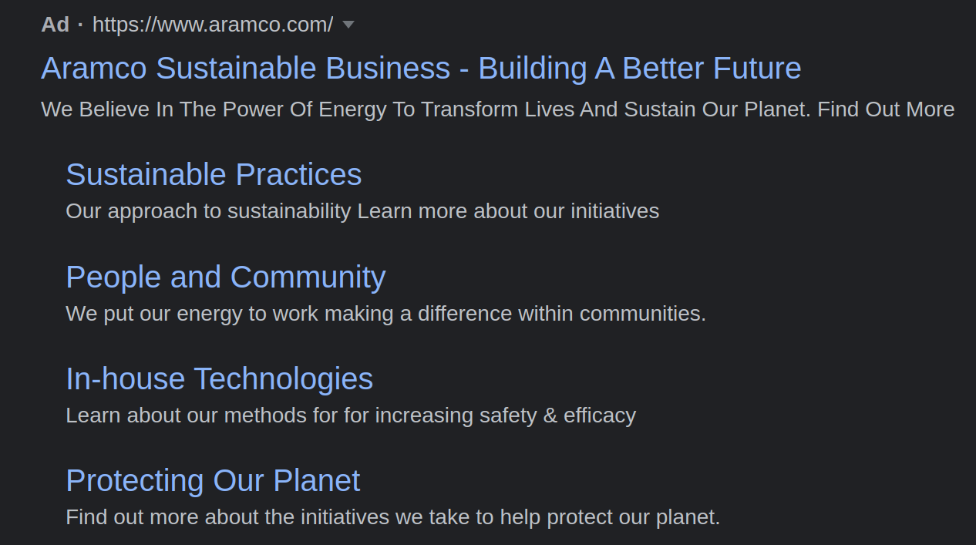
Fun Fact
Google Search Term “sustainable business cooperative”

Slide 71
Fun Fact
Google Search Term “sustainable business cooperative”
100 companies produced more than 70% of the world’s greenhouse gas emissions between 1988 and 2017
Guess who is on the list?
China (Coal) → 14.32%
Saudi Arabian Oil Company (Aramco) → 4.50%
Gazprom OAO → 3.91%
National Iranian Oil → 2.28%
ExxonMobil Corp → 1.98%
Coal India → 1.87%
Petroleos Mexicanos (Pemex) → 1.87%
Russia (Coal) → 1.86%
Royal Dutch Shell PLC → 1.67%
China National Petroleum Corp (CNPC) → 1.56%
BP PLC → 1.53%
Chevron Corp → 1.31%
Blaming individuals and denying any responsibility → great strategy!
https://www.theguardian.com/sustainable-business/2017/jul/10/100-fossil-fuel-companies-investors-responsible-71-global-emissions-cdp-study-climate-change

Slide 72
Act Now
Wales “One Planet Development”
“One Wales: One Planet”
Timeframe → one generation
Goal
Wales should use only its fair share of the earth’s resources
Zero carbon emissions for both use and construction
How?
Low Impact Development principles (applicable in Wales)
Prototypes / Test Communities
Single homes
Co-operative communities
http://www.oneplanetcouncil.org.uk/

Slide 73
Wrap-Up

Slide 74
Wrap-Up
Kate Marvel: “Courage is the resolve to do well without the assurance of a happy ending.”
You do not have to be a sustainability saint → be as sustainable as possible, it still makes a difference
Small progress vs. no progress
Silence/being inactive supports the destruction of our planet (← I just checked, still no “planet B” available)
Do something instead of giving up right away
Leading by example

Slide 75
Additional Resources
D. Thorpe (2015). The 'One Planet' Life – A Blueprint for Low Impact Development – Link
Documentary: Living the Change: Inspiring Stories for a Sustainable Future (2018) – Link
Documentary: A Simpler Way: Crisis as Opportunity (2016) – Link
Documentary: Capital in the 21st Century (2019) – Link
Jared Diamond (2019). Upheaval: How Nations Cope with Crisis and Change
How to Save a Planet – Electrify This! (Podcast) – Link
Food and Environment Reporting Network – Hot Farm (Podcast) – Link
D. Holmgren (2002). Permaculture: Principles & Pathways Beyond Sustainability
T. Piketty (2013). Capital in the 21st Century.

Slide 76
Questions?

